Slide 1
Draw Images Via Genetic Programming
Team number: 327
Team member: zixuan yu (001263991)
feng huang (001230993)

Slide 2
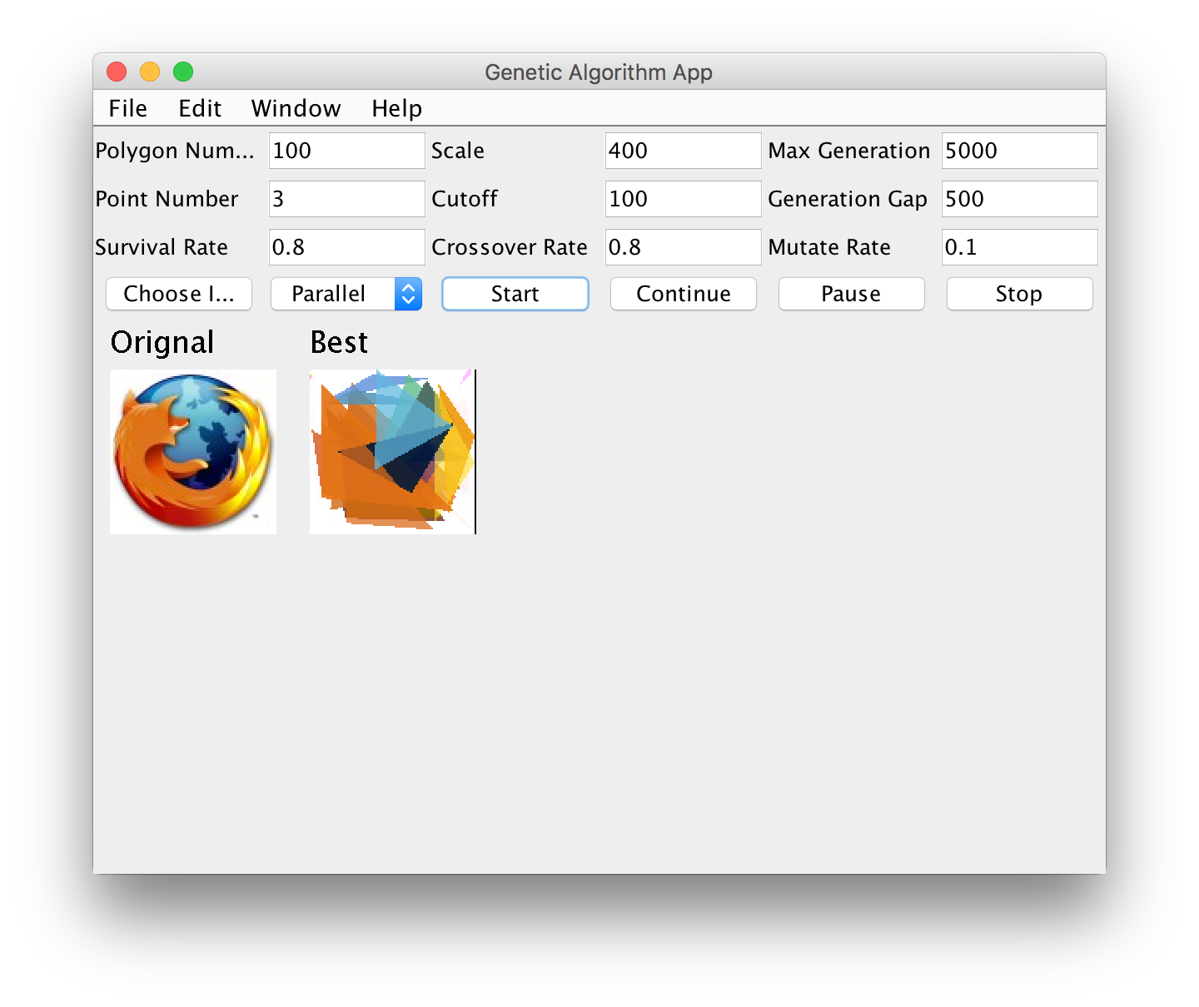
User interface

Slide 3
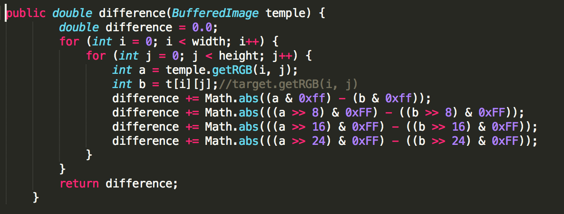
Fitness function: 1.Fitness is a sum of pixel-by-pixel differences from the original image 2.Lower number is better

Slide 4
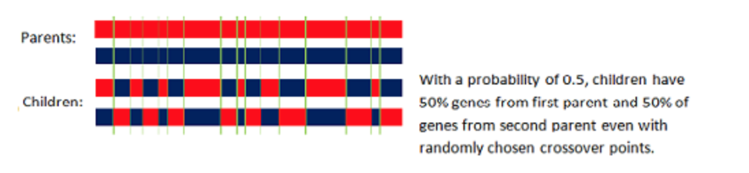
Crossing Over: use the uniform crossover, which evaluates each bit in the parent strings for exchange with a probability of 0.5.

Slide 5
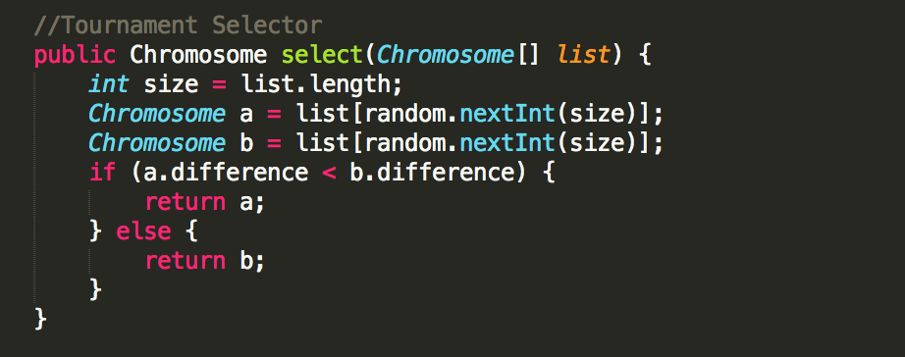
Selector: use the Tournament selection to choose two parents in crossover

Slide 6
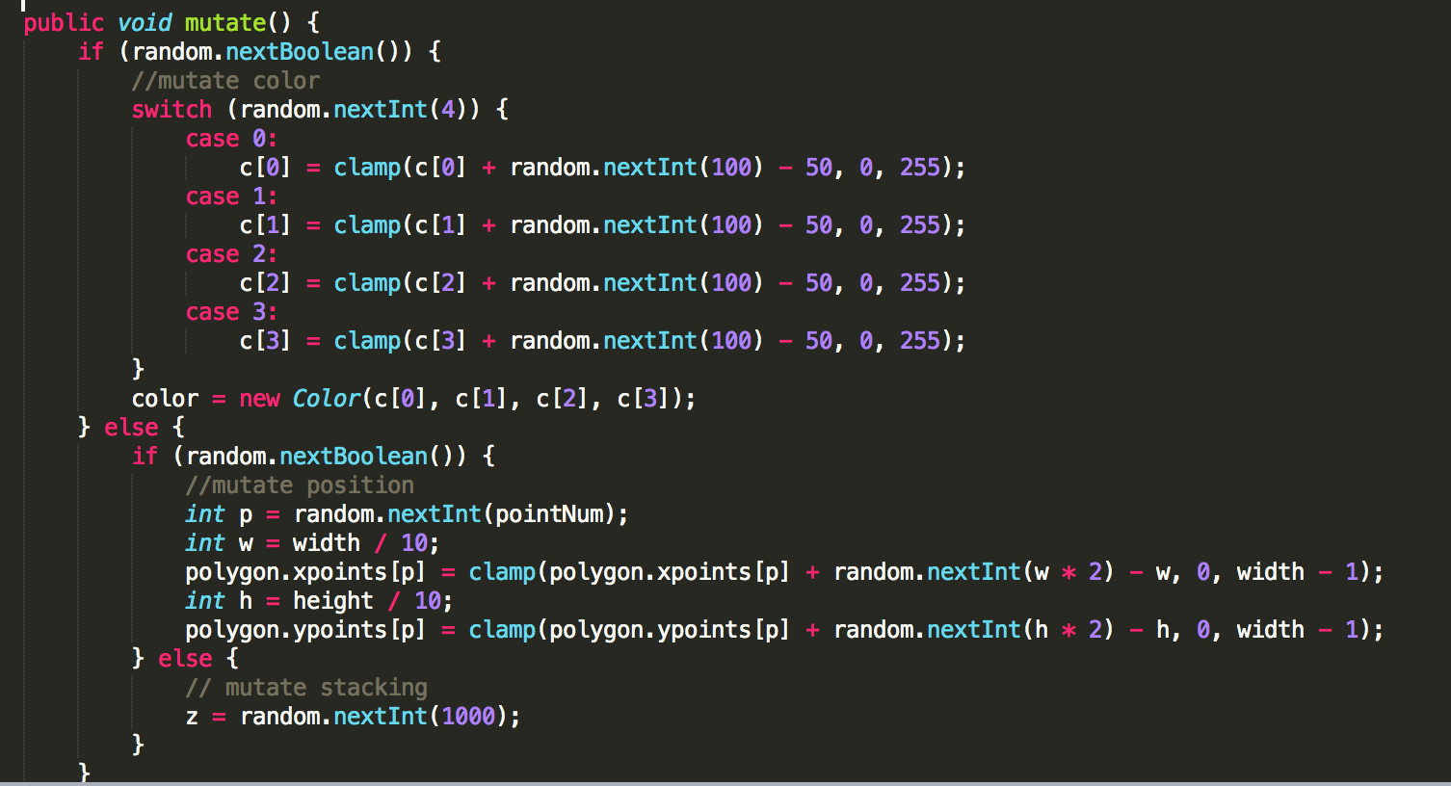
Mutation: change one of parameter (like color, stacking or position of vertices) to mutate

Slide 7
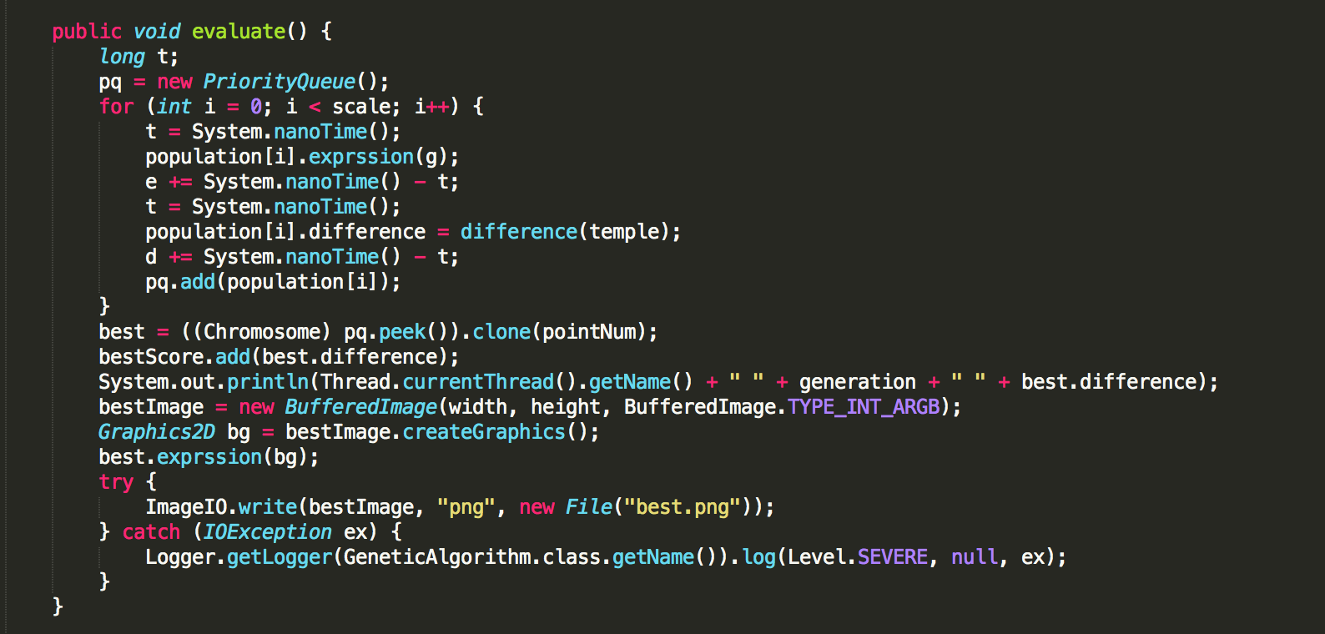
Evolution: 1. keep or discard 2. copy, mutation or crossover

Slide 8
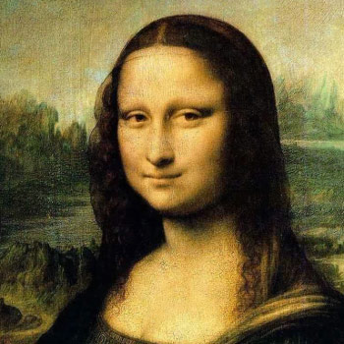
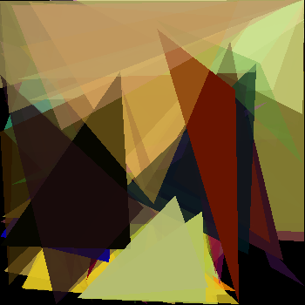
Parallel Processing: 1. cut off (each divided part is a thread) 2. gap (the number of evolution generation)

Slide 9
Fitness(difference)
Generation

Slide 10
Thanks for watching

